Slide 1
Officials Clinic for Open Water Judge and Referee
Revision 05 – May 2023
Prepared by Jim Riggs, NC Swimming

Slide 2
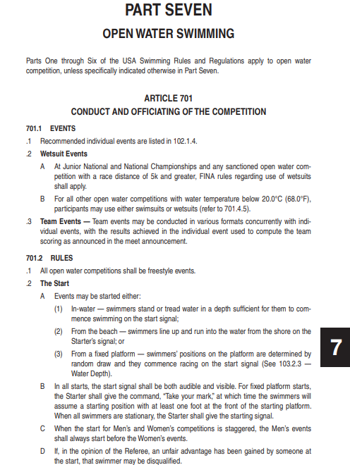
Contents
Contents
OW introduction
Certification
Safety
Roles and duties
Venue standards
Swimmer preparation
Official preparation
Rules
Scenarios
Next Steps
Revisions
Sample Pg.1, Sec. 7, USAS Rulebook

Slide 3
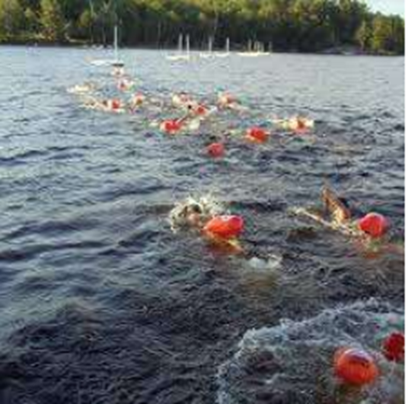
OW introduction
Safety is priority
Fresh, saltwater venues
Lake, river, pool, ocean environs
Course differences
Individual and team events
Varied starting formats
Time limits for events
Swimmer monitoring and retirement
Any stroke(s) allowed
Support on and along course

Slide 4
Officials Certification - Prerequisites
Open Water Judge:
Successful completion of USA Swimming Open Water Judge test with a score of 80% or better prior to attending an Open Water Clinic
If not a current LSC certified official, must complete the registration requirements, which include:
Annual USA Swimming non-athlete registration
Current Level 2 background check
Current Athlete protection training
If not a current LSC certified official: must complete the registration requirements, which include:
Annual USA Swimming non-athlete registration
Current Level 2 background check
Current Athlete protection training
https://www.usaswimming.org/officials/popular-resources/online-testing

Slide 5
Officials Certification – Prerequisites (2)
Open Water Starter/Referee:
Successful completion of USA Swimming OW Judge and Referee test with a score of 80% or better
Officials with ST/SR/DR current NCS certifications:
Attend 2 OW sessions in previous 12 months
https://www.usaswimming.org/officials/popular-resources/online-testing
Open Water Judge Officials Only:
Attend 4 OW sessions in previous 12 months
Definitions:
OW Meet or Event composed of:
OW Sessions or Races
Open Water Starter:
Current NCS Stroke & Turn judge, Starter, or Referee
Open Water Referee:
Currently certified as a NCS Referee

Slide 6
Officials Certification – Apprenticeship
Not current NCS ST, SR, or DR:
Observed in 4 sessions as an apprentice OW Judge
Open Water Judge Apprentice Process:
Attend an NCS Open Water Clinic and participate in a NCS OW Meet
Current NCS ST, SR, or DR:
Observed in 2 sessions as an apprentice OW Judge
Open Water Meet Referee/Clinician:
Notifies Officials Chair of successful completion of apprenticeship
Officials Chair:
With certification granted, notify apprentice and update certification in OTS

Slide 7
Officials Certification – Apprenticeship (2)
Open Water Starter/Referee Apprentice Process:
Attend an NCS Open Water Clinic and participate in a NCS OW Meet
Request OW Meet Referee to apprentice as Starter/Referee at OW Meet
Open Water Meet Referee/Clinician:
Notifies Officials Chair of successful completion of apprenticeship
Officials Chair:
With certification granted, notify apprentice and update certification in OTS

Slide 8
Officials Certification – Sustainment
Certification period:
Three-year term aligned with NCS Officials Certification
Recertification requirements:
Participate in one NCS Meet session as an OW Judge or two sessions as a OW Starter/Referee.
Maintain USAS Official Certification.
Pass applicable USAS OW Testing.

Slide 9
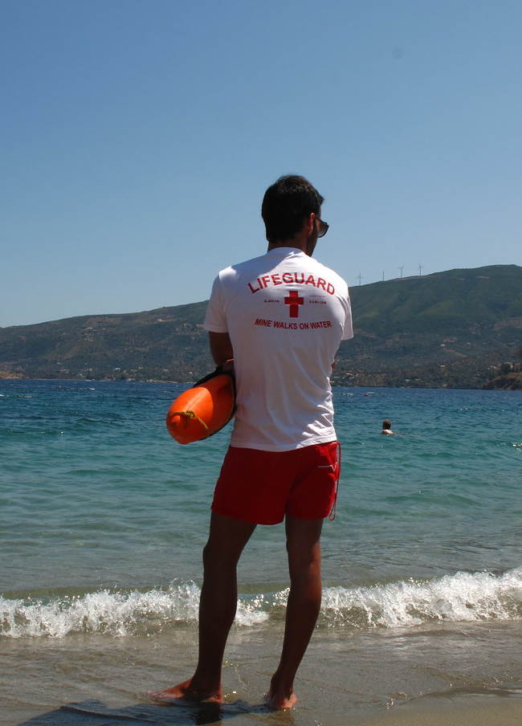
Safety
Safety is the priority
OW Meet Sanction must be approved by the Zone and then the LSC for all events
Meet Host Committee develops the Safety Plan per the sanction application
Authority to stop a race for safety is made at any time either by the required roles of :
Referee
Meet Director
Independent Safety Monitor
All officials are to be proactive in alerts for safety.
This Photo by Unknown Author is licensed under CC BY-SA-NC

Slide 10
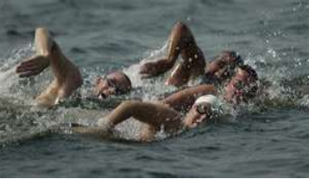
Rules and duties
Event Rules
Meet Host Committee includes in the meet information:
Policy for event abandonment
Escorted or unescorted swims:
Escorted: each swimmer observed
Un-escorted: swimmers observed in zones

Slide 11
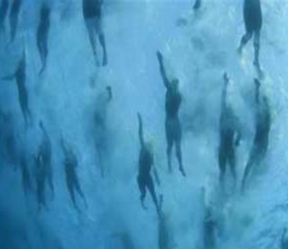
OW Sanction
Submission for approval prior to NCS sanction
Sanction must include:
Key personnel
Emergency Response Plan (ERP)
Course Abandonment Plan (CAP)
Independent Safety Monitor (ISM)
Water quality and site safety audit
Course map

Slide 12
Roles and duties
Meet Director
Primary contact for general meet activities
Leads Meet Host organization
Approval of sanction submittal
Defines and maintains course and venue
Authority to suspend/withdraw the sanction due to safety concerns.
May stop a swim at any time or safety concerns

Slide 13
Roles and duties (2)
ISM (Independent Safety Monitor)
Approved by LSC Sanction Chair
Independent of meet management; may supersede activities in the interest of safety.
Assures deployment of:
CAP (Course Abandonment Plan)
EAP (Emergency Response Plan)
Attends and supervises all elements of safety including:
Support resources
Environment
Authority to suspend/withdraw the sanction due to safety concerns.
May stop a swim at any time or safety concerns

Slide 14
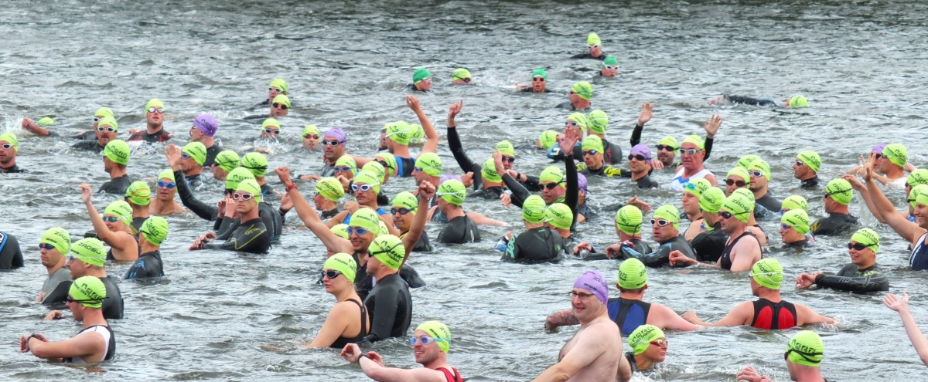
Roles and duties (3)
Officials:
Referee*
Chief Timer*
Safety Officer*
Finish Judge*
Starter
Admin Referee
Announcer
Clerk of Course
Recorder
Race/Turn Judge (Escorted/Unescorted Races)
* Dedicated Role

Slide 15
Roles and duties (4)
Referee
Pre-race briefing for participants, coaches, event personnel
Course
Markings
Signals
Authority to suspend the sanction due to safety concerns
Stop a session at any time for safety concerns
Use of video and other devices to verify order of finish
Signals start status
Defines starts in waves, age groups, and capabilities
Assistant Referee
Performs all duties assigned by the Referee

Slide 16
Roles and duties (5)
Admin Referee
Responsible for administrative duties
Safety Officer
Reports to Referee for all safety aspects
Directs escort craft
Verifies safe starts and finishes
Liaison to Medical Officer and updates safety and course revision
Medical Officer
Reports to Referee for all medical aspects
Updates medical support of events and evacuation process
Course Officer
Maintains course survey and verifies ready for use
Insures Turn Judges are in position

Slide 17
Roles and duties (6)
Turn Judge
Positions to verify swimmer compliance at turns
Reports possible infractions to the Referee
Chief Timer
Briefs and assign Timers to positions
Maintains the official clock
Chief Finish Judge
Briefs and assigns Finish Judges to positions
Determine order of finish and forwards to the Referee
Finish Judge
Records order of finish
Recorder
Completes finish information and results

Slide 18
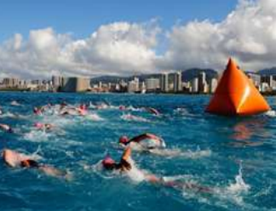
Course standards
Markers
Communicated in meet information and pre-race briefing instructions
Turn Buoys
Distinctive color and markings
Can be turned by the swimmer
Guide Buoys
Supplemental, non-directional
Assist the swimmer to remain on course
Additional Buoys
Start/Finish line management
Hazards (Stay Clear!)
Out of Race Areas (warm down area)

Slide 19
Course standards (2)
Water Depth
Except at Start and Finish, minimum depth of 4.6 ft. (1.4 m)
Water Quality
Meets standards of local testing authority
If recent, heavy rains of flooding have adverse affects the Referee may postpone the event
Water/Air Temperature
Water temperature not less than 60.8 F (16 C)
Races of 5K and more, water temperature no greater than 85 F (29.5 C)
Air and Water Temperatures added together not less than 118 F (30 C) and greater than 177 F (63 C)

Slide 20
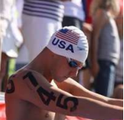
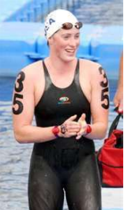
Swimmer markings and fingernails, etc.
Swimmer Marking
Vertically on each arm
Horizontally on each back shoulder
On each wrist (to support video at touch finish)
Referee may specify additional markings
Markings are used to identify participants:
At the start and during the swim for safety, coach contacts, possible infractions
At the finish to verify order of finish
Items that could cause injury must be removed
OW events are close-contact
Fingernails must be trimmed.
No watches or jewelry are allowed.

Slide 21
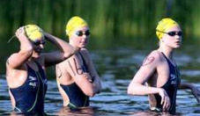
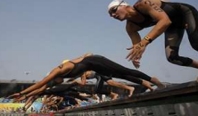
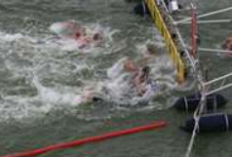
Starts, finishes
Starts
In water or platform
In water may require waves of swimmers
If platforms are used, must comply to USAS 1.3.2.3
Standing on bottom/deck or treading water
No running starts
Finish
Defined finish area with “chute” approach
Timers recorded times (including attached chips) is the official time
Finish placement determined by manual finish judging and/or video if needed

Slide 22
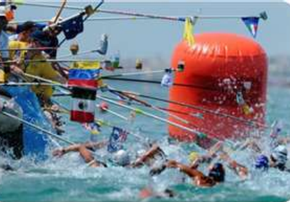
Feeding stations
Required for events greater than 5K:
One station for events greater than 5K and less than 10K
For events 10K or longer, stations located every 2K
Stations may be stationary or floating (anchored)
Stations located on the inner or outer boundary of the course in-line with site buoys
Team assigned on the station assigned by lots

Slide 23
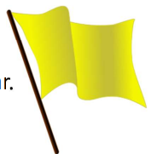
Rules summary
Yellow Flag Warning
Gaining an unfair advantage at the Start (may escalate to a Red Flag
Receiving pacing
Slipstreaming escort craft; refusal to swim clear pf these items
Swimmer’s escort intentionally interferes with another swimmer
Intentional contact of interference with another swimmer

Slide 24
Rules (2)
Red Flag Disqualifications
Two flags to a swimmer: one yellow flag, the next is a red flag for additional violation
Failing to finish course
Receiving assistance (pulling on cables, markers)
Receiving propulsion aid
Walking on or pushing off the bottom
Receiving support from fixed or floating objects (intentional contact)
Unsporting conduct including intentionally striking a swimmer, refusing to correct a missed turn, intentional interference to another swimmer
Swimwear violations including illegal suit or floatation.
Swimmer receiving a red flag disqualification with Referee acceptance must leave the water immediately
Admin Referee is notified, and swimmer is removed from event

Slide 25
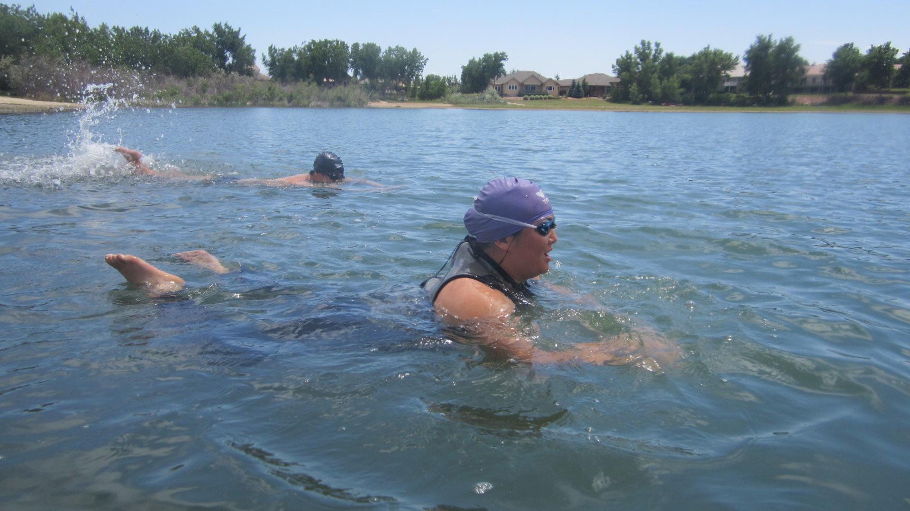
Ruling example
Situation:
In a straight-away of the course a Turn Judge observes Swimmer #77 performing a Butterfly Stroke with an Alternating Kick to pass another swimmer.
What action is to be taken?
Nothing. Open Water are free style events. The swimmer may swim in any manner desired. Various strokes may be used.

Slide 26
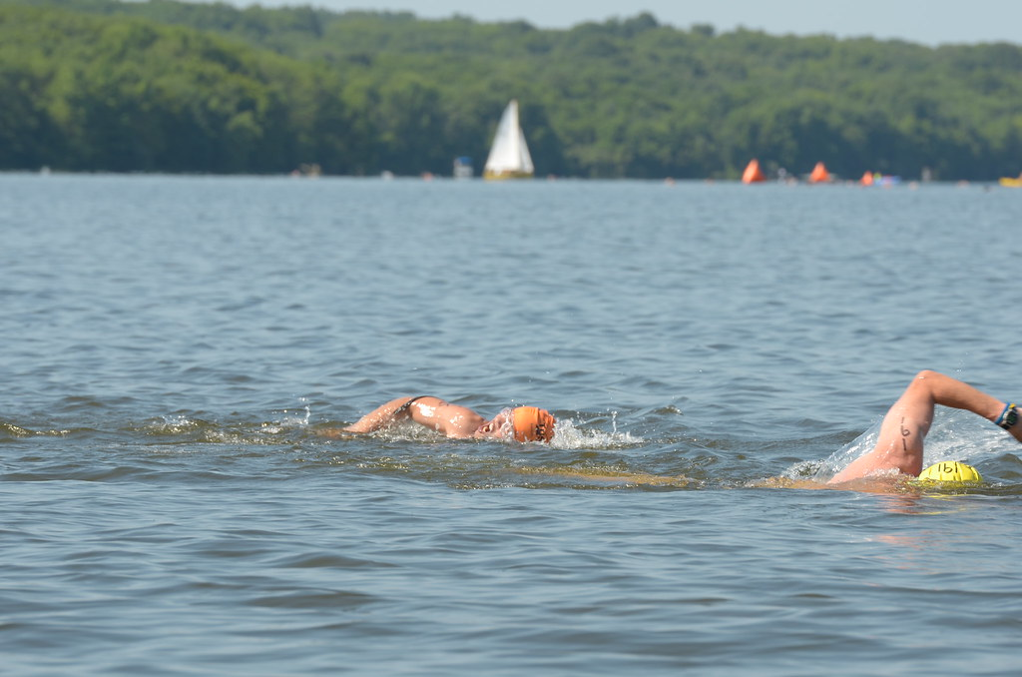
Ruling example (2)
Situation:
In a 5K race at the 2K distance, the feet of Swimmer #9 makes intentional contact with the goggles of Swimmer #3 who is directly behind Swimmer #9 causing the goggles to fill with water. Swimmer #3 stops swimming and treads water to reaffix the goggles. The Referee observed the situation.
What action is to be taken?
The Referee immediately alerts Swimmer #9 to give a yellow flag caution for intentional contact which causes interference.

Slide 27
Ruling example (3)
Situation:
In the previous 5K race continued, at the 4K distance, Swimmer #9 again makes intentional contact with Swimmer #101 who is beside Swimmer #9. The Referee observed the situation.
What action is to be taken?
The Referee immediately alerts Swimmer #9 to give a red flag disqualification for repeated intentional contact which causes interference to another swimmer. Swimmer #9 is removed from the race.

Slide 28
Ruling example (4)
Situation:
Swimmer #88 appears to have difficulty. A safety craft approaches. The swimmer states he does not think he can go further and grabs the ladder of the craft. The swimmer’s coach shouts encouragement to continue. Swimmer #88 releases contact of the craft and continues swimming.
What action is to be taken?
The Referee immediately alerts Swimmer #88 to give a red flag disqualification for contact of a watercraft. Swimmer #88 is removed from the race.

Slide 29
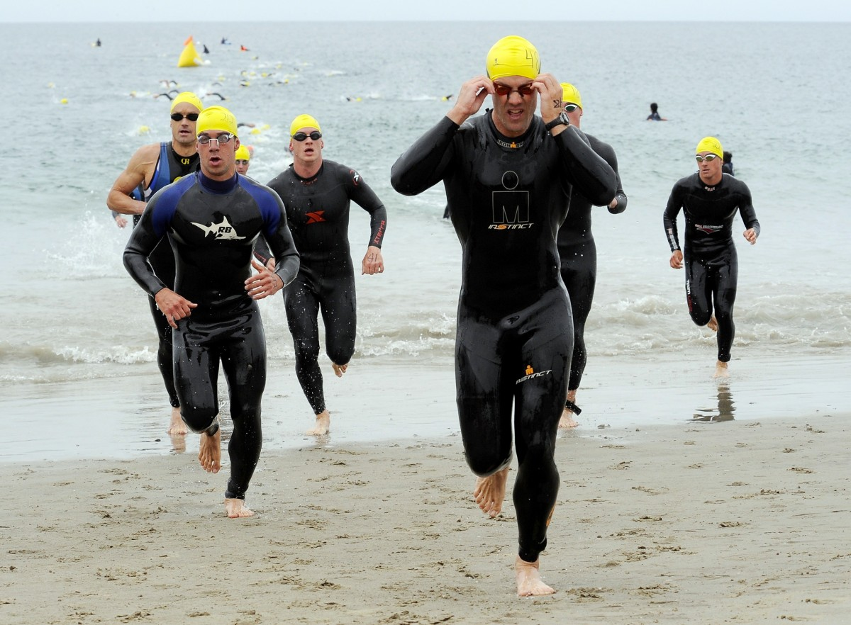
Ruling example (6)
Situation:
At the finish, Swimmer #100 stumbles while entering the chute. Swimmer #13 assists Swimmer #100 to stand up and finish.
What action is to be taken?
No action. Neither swimmer received an advantage or hindered another from finishing the event. No aided forward advance occurred.

Slide 30
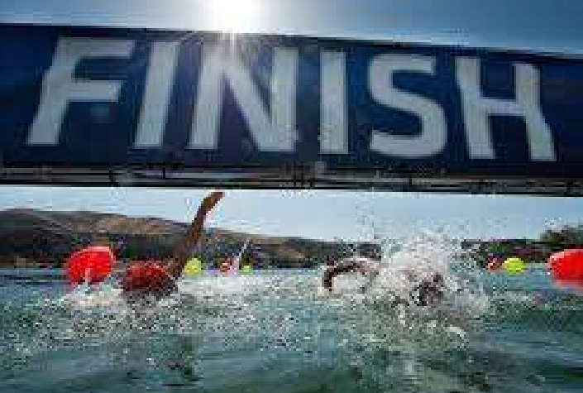
Thank you

