Slide 1


Generic Officials Briefing
Can be used as a base to build a specific presentation
Includes:
An introduction page
An alternate Stroke briefing
MAAPP for Officials
Various Long Course Protocols

Slide 2
Officials Briefing
Please sign in so you can be assigned a position
  Be prepared to show DECK PASS or USA membership card
You should be prepared to work the COMPLETE session
You should have a pen and access to DQ slips
Enjoy the hospitality and please be on deck 10 minutes prior to the start

Slide 3
MAAPP - Officials Briefing:
This meet is conducted according to current USA Swimming Rules, including the Minor Athlete Abuse Prevention Policy.
Make sure all interactions with athletes are observable and interruptible.
Deck changing is prohibited. Report instances of deck changing to the meet referee/meet director.
[IF ONE LOCKER ROOM/RESTROOM] Make sure you are not alone with an athlete in the locker room, including to use the restroom. Be proactive and tell the meet director immediately if this happens, even when it occurred through no fault of your own. Separate times have been delegated for your use.
[IF MULTIPLE FACILITIES] There is a separate locker room/restroom for athletes and all other adults. Make sure that you are only using the facility marked for you.

Slide 4
Stroke Briefing
Butterfly – Forward Start - Head must surface at or before 15 meter at start & turns
Body is toward the breast during the swim
One or more butterfly kicks are allowed after the start and turn
First arm pull must bring the swimming to the surface - must stay on surface
Arms must be brought forward over the surface of the water
Both kicks and arm pulls must be simultaneous
At the turns, when the feet leave the wall, shoulders must be towards breast
For turns and finishes…two-hand separated simultaneous touch are at, above, or below.

Slide 5
Stroke Briefing
Backstroke – Backward Start - Head must surface at or before 15 meter at start & turns
Toes stay below the gutter line (before = starter jurisdiction) (after = S&T jurisdiction)
Swimmer can progress in any manner they choose…body must be toward the back
Some part of the head must break surface before the 15m and remain on the surface
After passing the backstroke flags, swimmer may flip toward breast provided that it is followed by:
  a single or simultaneous double arm pull and an upward or downward movement of the head
At the turn some part of swimmer must touch wall
When the feet leave the wall shoulders must be towards back
Must remain on the surface and be on back at the finish

Slide 6
Stroke Briefing
Breast Stroke – Forward Start - No 15 Meter Rule
Cycle Stroke: pull-kick…pull-kick … body toward the breast
Hands pushed forward from breast on/under/over the surface of the water.
Elbows must stay in contact with the surface of the water – except turns and finish
At starts and turns, may use one downward butterfly kick...before the first breast stroke kick
may be joined/followed by one full arm pull past the hipline
2nd arm pull must bring head to the surface before hands turn inward at the widest part of the pull
Both pulls and kicks are simultaneous and on the same horizontal plane.
Feet are pointed outward during propulsive phase.
When the feet leave the wall shoulders must be towards breast
For turns and finishes…two-hand separated simultaneous touches at, above, or below.

Slide 7
Stroke Briefing
Freestyle – Forward Start - Head must surface at or before 15 meter at start & turns
Swimmer must swim on the surface and it can be in any manner they choose
  except in IM and Medley
At the turn and finish some part of the swimmer must touch wall
IM (Order = FLY, BACK, BREAST, FREE) MEDLEY (Order = BACK, BREAST, FLY, FREE)
NOTE: The final leg of and IM and Medley Relay is FREESTYLE so…
  it can be anything except the other three strokes and must be on the breast
  swimmer cannot cover more than ¼ of the distance in the style of backstroke
Intermediate turns are judged as turns; stroke transitions are judged as a finish
Takeoff judging >>> observe feet leaving platform then look for hands at the wall/pad

Slide 8
General Turn Judge Jurisdiction and Deck Protocols
Jurisdiction is wall to flags - first stroke out and last stroke in
Start protocol: At long whistle one step back from rear of block, step up after start signal and step back after swimmers is beyond observable distance
Turn protocol: Move to edge when lead swimmer reaches flags, step back after swimmers turn and resurface
Finish protocol: Move to edge when lead swimmer reaches flags

Slide 9
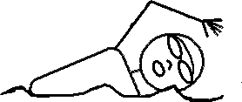
General Stroke Judge Jurisdiction and Deck Protocols
Jurisdiction is wall-to-wall for all 4 lanes on your side of the pool
Lead and lag position themselves “off the feet”
Avoid facing ‘sideways’
Be sure the “mirror” opposite side of the pool.
Only 1 stroke judge for 2 or less swimmers in your jurisdiction.
If swimmers separate “greatly”, LEAD and LAG should use their best judgment
8 |  |  |  | 8
7 |  |  |  | 7
6 |  |  |  | 6
5 |  |  |  | 5
4 |  |  |  | 4
3 |  |  |  | 3
2 |  |  |  | 2
1 |  |  |  | 1

Slide 10
Basic Long Course Stroke Protocol
BACKSTROKE
BUTTERFLY
8 |  |  |  | 8
7 |  |  |  | 7
6 |  |  |  | 6
5 |  |  |  | 5
4 |  |  |  | 4
3 |  |  |  | 3
2 |  |  |  | 2
1 |  |  |  | 1
15M
15M
M
I
D
P
O
O
L
15M
15M
BREAST
DR
SR
DR
SR

Slide 11

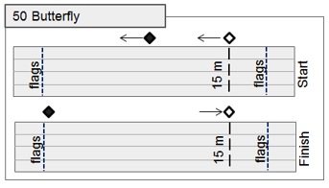
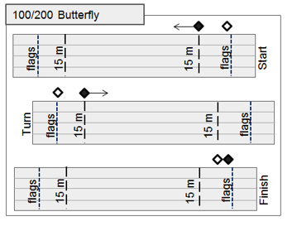
Jurisdiction and Deck Protocols
50 Butterfly
At Start: LEAD is mid-pool, LAG observes 15m mark then follows behind feet of last swimmer to mid-pool.
100/200 Butterfly
At Start: LEAD is at 15m, LAG is near flags. LEAD observes 15m mark, then follows behind feet of 2nd swimmer. LAG follows behind feet of last swimmer.
At Turn: LEAD walks to flags at turn end, then stops at 15m mark – ready for the next heat at 15M mark

Slide 12
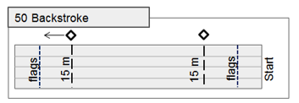
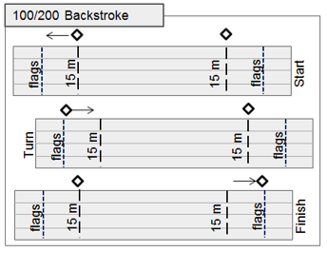
Jurisdiction and Deck Protocols
ALL Backstroke
Stroke judges stand at the two 15m marks and walk between 15m mark and flags to observe turns and finishes for their respective ends of the pool.

Slide 13
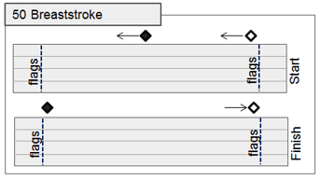
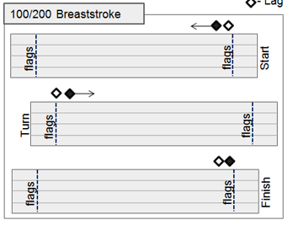
Jurisdiction and Deck Protocols
50 Breaststroke
At Start: LEAD is mid-pool, LAG is near flags and then follows behind feet of last swimmer to mid-pool.
At Finish: LEAD follows behind feet of last swimmer from mid-pool to flags and observes the finish. LAG returns to start-end flags.
100/200 Breaststroke
At Start: LEAD and LAG are near flags. LEAD follows behind feet of 2nd swimmer. LAG follows behind feet of last swimmer.
At Turn: LEAD and LAG walk to flags at turn end. LAG becomes LEAD and follows behind feet of 2nd swimmer. LEAD becomes LAG follows behind feet of last swimmer.
At Finish: LEAD and LAG walk to flags to observe finish.

Slide 14
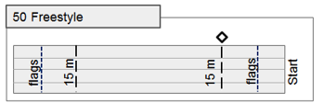
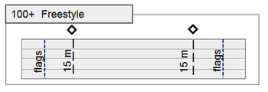
Jurisdiction and Deck Protocols
Freestyle
50 - A stroke judges stand and observes the start-end 15m mark.
100 - Stroke judges stand and observe at both 15m marks.
200(+) - Start-end 15m judges stand for the start, then sit. Turn-end 15m judges stand for 2nd- 50, then sit for remainder of race.

Slide 15
Unique Jurisdictions and Deck Protocols
200 Individual Medley
Butterfly: As above, LAG observes 15m mark for start of backstroke
Back: LEAD and LAG walk to Breaststroke start positions to observe Backstroke finish and Breaststroke start
Breaststroke: LEAD and LAG walk flag to flag
Freestyle: Breaststroke LAG observes 15m mark, then returns to Butterfly start positions
400 Individual Medley
Butterfly: As above, LAG observes 15m mark for start of backstroke
Back: LEAD only walks to turn end to observe turn and 15m mark, then returns to Breaststroke start position. Breaststroke: LEAD and LAG walk flag to flag
Freestyle: Breaststroke LAG observes 15m mark, then both judges return to Butterfly start positions
Medley Relays
Start in Backstroke Positions, move to Breaststroke start position, then follow LEAD-LAG protocol as above

