Slide 1
Basic Long Course Protocol
John Jewell - 2016

Slide 2

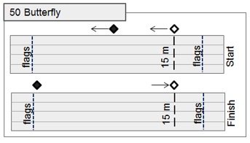
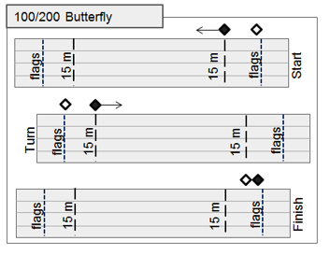
Jurisdiction and Deck Protocols
50 Butterfly
At Start: LEAD is mid-pool, LAG observes 15m mark then follows behind feet of last swimmer to mid-pool.
100/200 Butterfly
At Start: LEAD is at 15m, LAG is near flags. LEAD observes 15m mark, then follows behind feet of 2nd swimmer. LAG follows behind feet of last swimmer.
At Turn: LEAD walks to flags at turn end, then stops at 15m mark – ready for the next heat at 15M mark

Slide 3
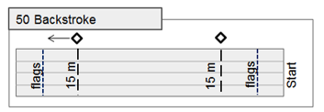
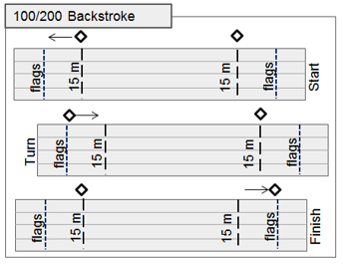
Jurisdiction and Deck Protocols
ALL Backstroke
Stroke judges stand at the two 15m marks and walk between 15m mark and flags to observe turns and finishes for their respective ends of the pool.

Slide 4
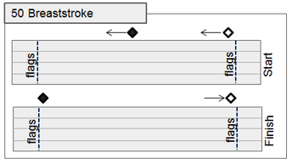
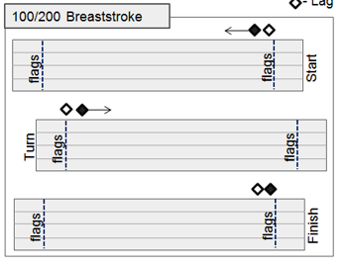
Jurisdiction and Deck Protocols
50 Breaststroke
At Start: LEAD is mid-pool, LAG is near flags and then follows behind feet of last swimmer to mid-pool.
At Finish: LEAD follows behind feet of last swimmer from mid-pool to flags and observes the finish. LAG returns to start-end flags.
100/200 Breaststroke
At Start: LEAD and LAG are near flags. LEAD follows behind feet of 2nd swimmer. LAG follows behind feet of last swimmer.
At Turn: LEAD and LAG walk to flags at turn end. LAG becomes LEAD and follows behind feet of 2nd swimmer. LEAD becomes LAG follows behind feet of last swimmer.
At Finish: LEAD and LAG walk to flags to observe finish.

Slide 5
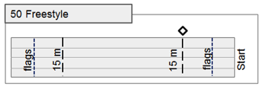
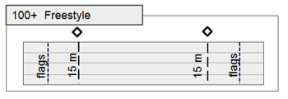
Jurisdiction and Deck Protocols
Freestyle
50 - A stroke judges stand and observes the start-end 15m mark.
100 - Stroke judges stand and observe at both 15m marks.
200(+) - Start-end 15m judges stand for the start, then sit. Turn-end 15m judges stand for 2nd- 50, then sit for remainder of race.

Slide 6
Unique Jurisdictions and Deck Protocols
200 Individual Medley
Butterfly: As above, LAG observes 15m mark for start of backstroke
Back: LEAD and LAG walk to Breaststroke start positions to observe Backstroke finish and Breaststroke start
Breaststroke: LEAD and LAG walk flag to flag
Freestyle: Breaststroke LAG observes 15m mark, then returns to Butterfly start positions
400 Individual Medley
Butterfly: As above, LAG observes 15m mark for start of backstroke
Back: LEAD only walks to turn end to observe turn and 15m mark, then returns to Breaststroke start position. Breaststroke: LEAD and LAG walk flag to flag
Freestyle: Breaststroke LAG observes 15m mark, then both judges return to Butterfly start positions
Medley Relays
Start in Backstroke Positions, move to Breaststroke start position, then follow LEAD-LAG protocol as above

